Slide 1
NASA New Horizons Parallax Educational Outreach Program
Bill Hanna
Columbia Falls, Montana
TTSO14 Online
Monday 13 April 2020
Notes:
This is not really about occultations, but it is an opportunity for all observers (in the southern hemisphere, in particular) to participate in a NASA project.

Slide 2
Topics
NASA Educational Outreach Program
Target Stars for Parallax Determination
Recent Star Images
Associated Web Sites For More Information
Notes:
I will discuss this at a high level, and direct interested observers to the web sites near the end of the presentation for more details.
The New Horizons spacecraft has completed its Pluto (July 2015) and Arrokoth (2014 MU69, Ultima Thule; January 2019) missions and will now be used for an EOP. There is a long-term goal of developing autonomous on-board navigation for very-deep space missions.
Two target stars: Proxima Centauri and Wolf 359. They are among the closest stars to our sun and exhibit a significant proper motion.
Images taken from my observatory at Yass.
List of NASA web sites.

Slide 3
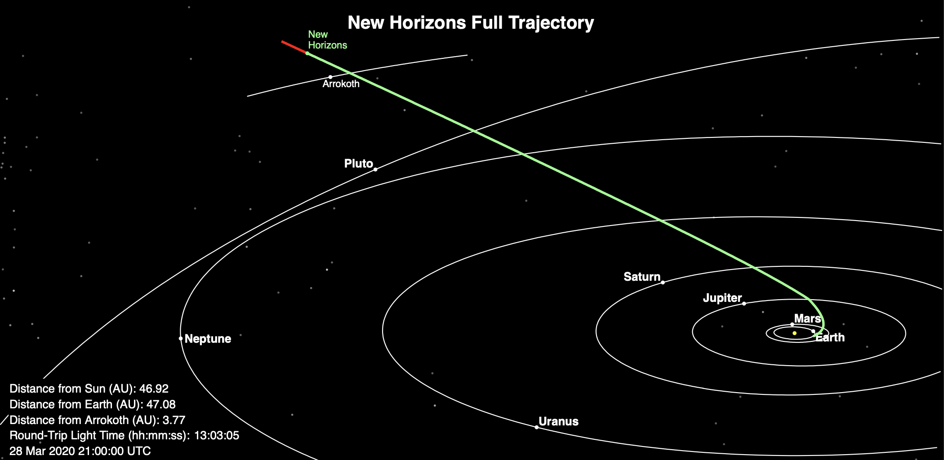
New Horizons is Healthy
NASA
Notes:
The spacecraft is in excellent health, and the power and propulsion systems maintain significant margins. It could potentially continue to return data for decades, so the investigators are looking for other mission opportunities.

Slide 4
Targets Are Two Nearby Stars
Proxima Centauri
UCAC4 137-116050
14h 29m 28s / -62° 40’ 26” (of date; approximate)
Mag 11.1
4.2 ly
Wolf 359
UCAC4 486-052877
10h 56m 26s / +06° 59’ 28” (of date; approximate)
Mag 13.0
7.9 ly
Notes:
Be careful when looking up the star positions (in C2A, or via the ESO Online Digitized Sky Survey) as they have a high proper motion and will not display accurately of date. Consult the images later in the presentation; the given coordinates are the centres of those images.
Both are known to be flare stars.

Slide 5
Proxima Centauri
New Horizons image at 20200422/1300 UT
Wednesday 20200422/2300 AEST
Yass particulars
Never Sets
0731 UT Sunset
0856 UT End Astronomical Twilight
1300 UT Ideal Image Time (59° elev @ 160° az)
1425 UT Transits
Notes:
Note that New Horizons will take two exposures. This is the one appropriate for Australasian observers.
The ideal imaging time is given, but any images taken with a few days on either side would still be useful. Most northern hemisphere observers cannot see this star at all, and many of the major observatories in the southern hemisphere (e.g., in Chile) are not operating at full capacity due to COVID-19 issues, so amateur observations are encouraged.

Slide 6
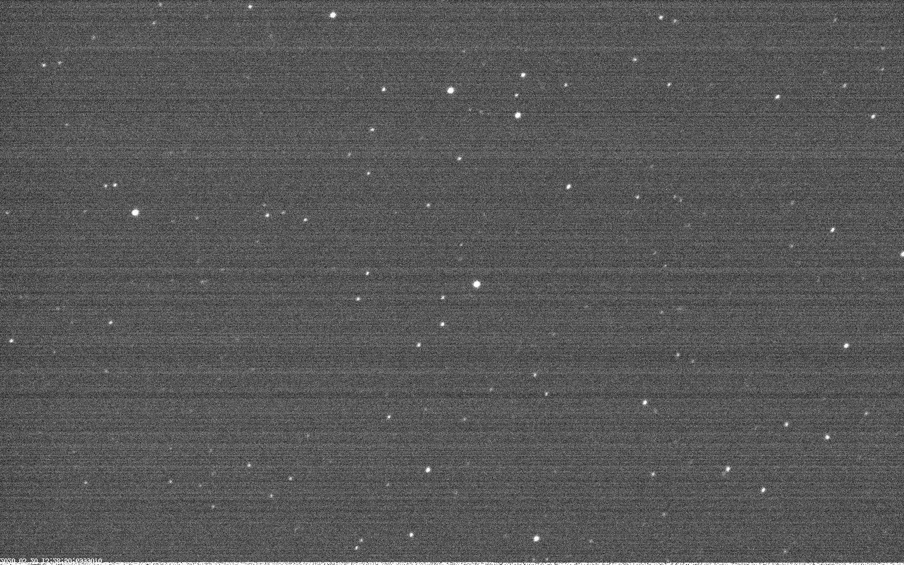
Proxima Centauri (just saturated)
17.0 x 10.6 arc-minutes
Notes:
Proxima Centauri is in a rich star field, so even with an exposure that just begins to saturate the star (100ms in this case) there are a number of field stars available for an astrometric solution. (Depending on your equipment you might need to rotate/flip these images, which measure 17.0 x 10.6 arc-minutes.)

Slide 7
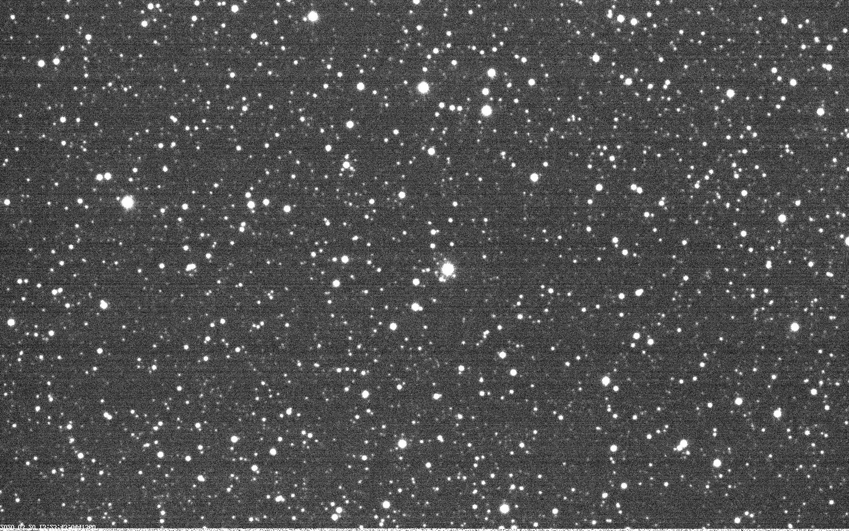
Proxima Centauri (rich field)
17.0 x 10.6 arc-minutes
Notes:
With a heavily saturated exposure (4s in this case) a very large number of field stars become available. The best plan would be to collect a number of frames at a number of different exposures, then choose the “pick of the litter” for each exposure to report. Be sure to record the time of the exposure!

Slide 8
Wolf 359
New Horizons image at 20200423/1000 UT
Thursday 20200423/2000 AEST
Yass particulars
0511 UT Rises
0731 UT Sunset
0856 UT End Astronomical Twilight
1000 UT Ideal Image Time (46° elev @ 019° az)
1057 UT Transits
1637 UT Sets
Notes:
The ideal imaging time is given, but any images taken with a few days on either side would still be useful.
Note that New Horizons will take two exposures. This is the one appropriate for Australasian observers.

Slide 9
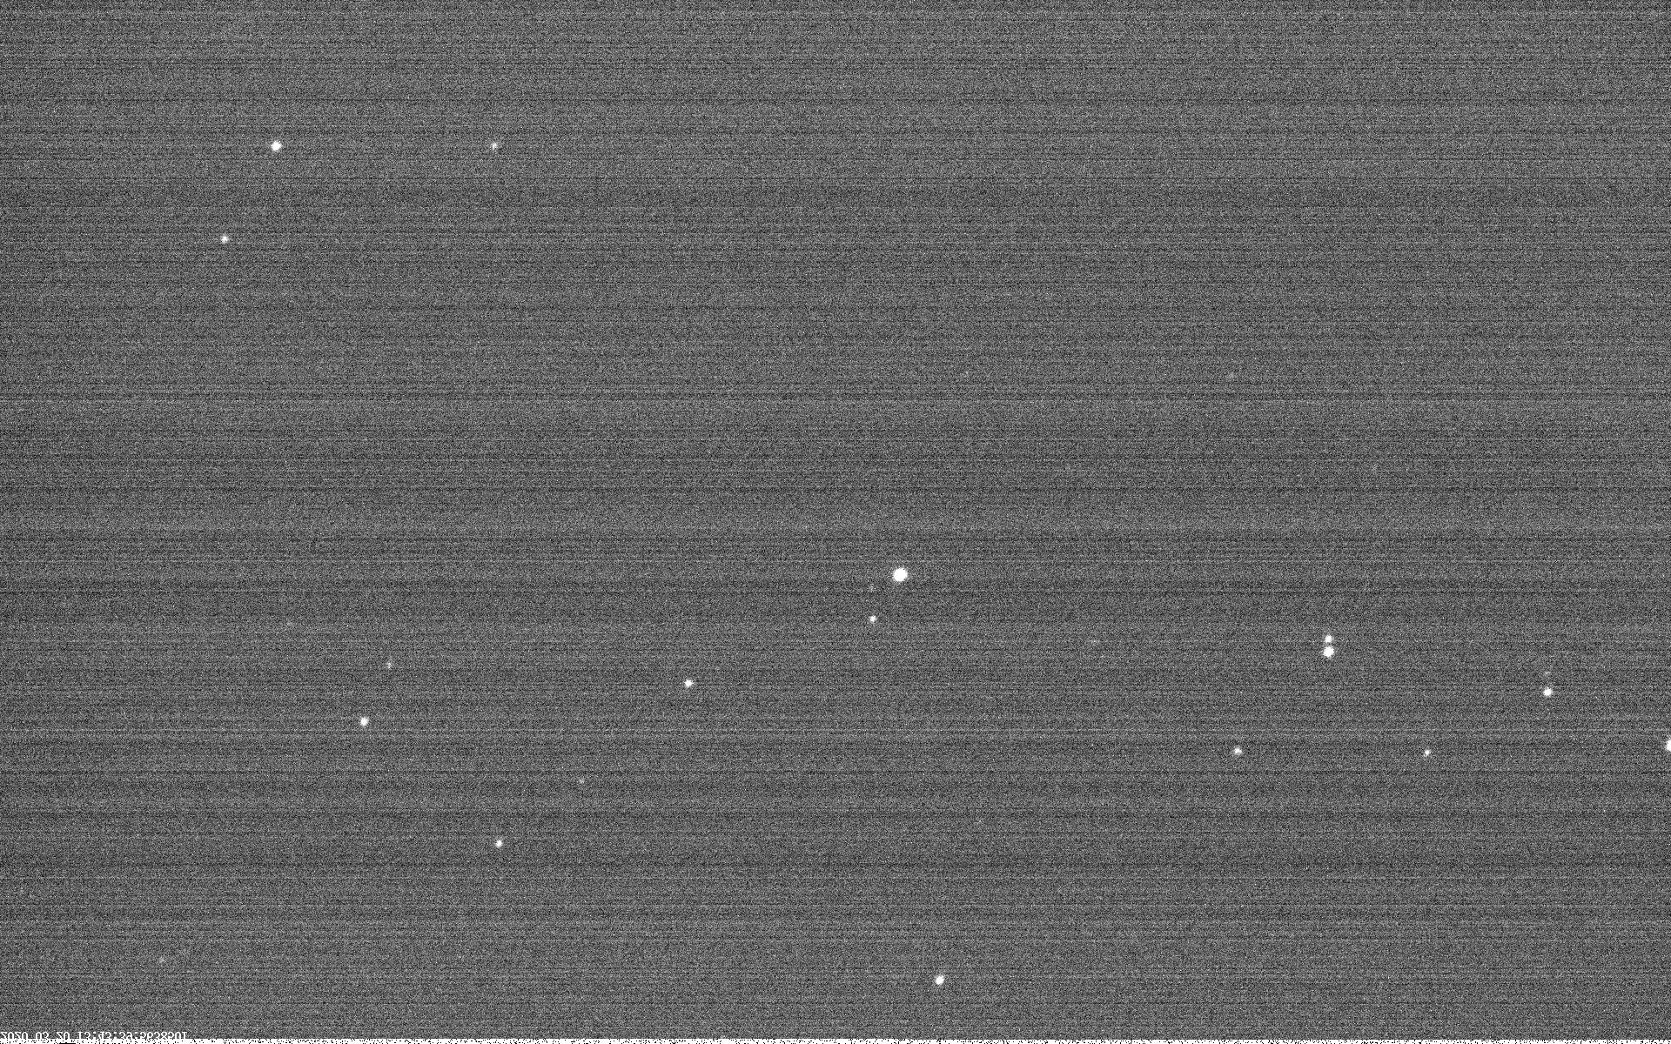
Wolf 359 (just saturated)
17.0 x 10.6 arc-minutes
Notes:
Wolf 359 is in a much weaker star field, so with an exposure that just begins to saturate the star (1s in this case) there are only a few field stars available for an astrometric solution. (Depending on your equipment you might need to rotate/flip these images, which measure 17.0 x 10.6 arc-minutes.)

Slide 10
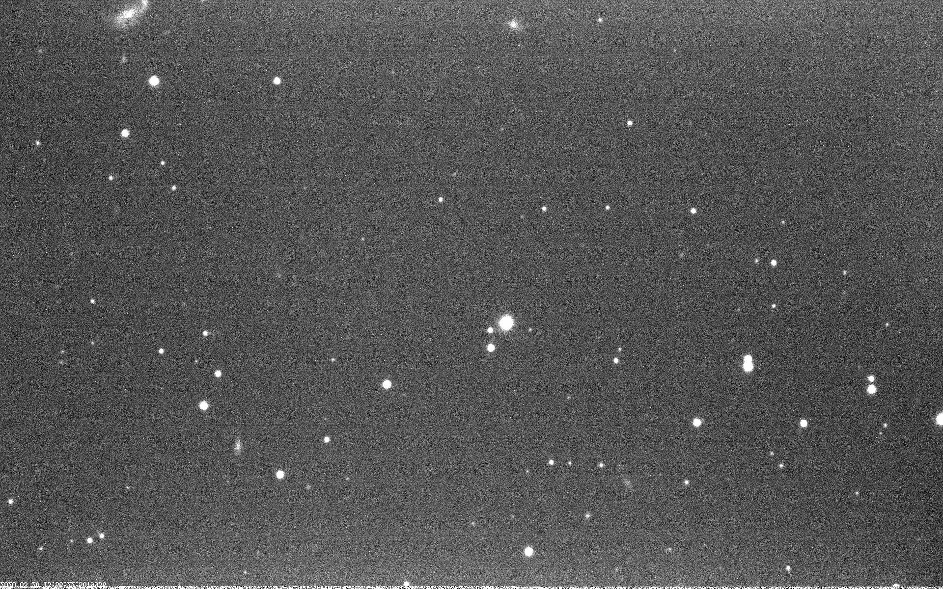
Wolf 359 (rich field)
17.0 x 10.6 arc-minutes
Notes:
Even with a heavily saturated exposure (15s in this case) there are still only a modest number of field stars (and a few galaxies!) available. The best plan would be to collect a number of frames at a number of different exposures, then choose the “pick of the litter” for each exposure to report. Be sure to record the time of the exposure!

Slide 11
Associated Web Sites
http://pluto.jhuapl.edu/News-Center/News-Article.php?page=20200129
http://pluto.jhuapl.edu/Learn/Get-Involved.php#Parallax-Program
Notes:
Much more detail is available at these web sites.

Slide 12
Reporting Observations
Dr. Tod R. Lauer (lauer@noao.edu)
National Optical Astronomy Observatory
Send Images via DropBox (or similar)
Notes:
Dr. Lauer is coordinating this effort from Tucson, Arizona, but the recent COVID-19 issues have thrown a spanner in the works as far as reporting is concerned. I hope to have an update soon.

Slide 13
Questions?
Notes:
Questions?

