Slide 1
Welcome to vTTSO14
The Fourteenth Trans-Tasman Symposium on Occultations
RASNZ Occultation Section
Parkes, New South Wales, Australia - Cyberspace

Slide 2
This is an experiment
Holding a conference is a format like this is new for all of us. Please bare with us if it feels a bit ‘clunky.’
We expect today to put a heavier load on the MeetCheap system than we have used the past – not expecting trouble at this stage.
Not sure on the details yet but … we are hoping to put all of the presentations on the RASNZ Occultation Website (www.occultations.org.nz ) after the conference rather then distributing DVD’s/USB sticks.
How do we do a group photo? Send your webcam selfie to Director@occultations.org.nz (not compulsory)

Slide 3
Program for today
UT | NZ time | AEST (Aust East Std) | Title | Presenter
12/04/2020 11:00 PM | 13/04/2020 11:00 AM | 13/04/2020 9:00 AM | Asteroidal occultation results for Australia and New Zealand for 2019. | Steve Kerr
 |  |  | Highlights of minor planet occultations over the last year | Dave Herald
12/04/2020 11:30 PM | 13/04/2020 11:30 AM | 13/04/2020 9:30 AM | The NASA Educational Outreach Program in support of New Horizons, imaging Proxima Centauri and Wolf 359 to demonstrate stellar parallax. | Bill Hanna
12/04/2020 11:45 PM | 13/04/2020 11:45 AM | 13/04/2020 9:45 AM | TT~14 feed and Generating Personal Predictions for OccultWatcher | Dave Gault
13/04/2020 12:00 AM | 13/04/2020 12:00 PM | 13/04/2020 10:00 AM | break
13/04/2020 12:30 AM | 13/04/2020 12:30 PM | 13/04/2020 10:30 AM | Issues with the use of a QHY174M-GPS camera | Bill Hanna
13/04/2020 1:00 AM | 13/04/2020 1:00 PM | 13/04/2020 11:00 AM | recent changes in asteroid reductions in Occult | Dave Herald
13/04/2020 1:30 AM | 13/04/2020 1:30 PM | 13/04/2020 11:30 AM | A first look at PyMovie | Martin Unwin
13/04/2020 2:00 AM | 13/04/2020 2:00 PM | 13/04/2020 12:00 PM | lunch break
13/04/2020 3:00 AM | 13/04/2020 3:00 PM | 13/04/2020 1:00 PM | Review of the Asteroidal Occultation dataset | Dave Gault
13/04/2020 3:30 AM | 13/04/2020 3:30 PM | 13/04/2020 1:30 PM | Shape models | Dave Herald
13/04/2020 4:00 AM | 13/04/2020 4:00 PM | 13/04/2020 2:00 PM | Ultra-Portable Telescopes for Occultation Expeditions | John Broughton
13/04/2020 4:30 AM | 13/04/2020 4:30 PM | 13/04/2020 2:30 PM | Adventures with Focal Reducers | Steve Kerr
13/04/2020 5:00 AM | 13/04/2020 5:00 PM | 13/04/2020 3:00 PM | break
13/04/2020 5:30 AM | 13/04/2020 5:30 PM | 13/04/2020 3:30 PM | Phemu 2021 | Dave Herald
 |  |  | Horizons predictions | Dave Herald
13/04/2020 6:00 AM | 13/04/2020 6:00 PM | 13/04/2020 4:00 PM | Highlights of double star occultations over the last year | Brian Loader
13/04/2020 6:15 AM | 13/04/2020 6:15 PM | 13/04/2020 4:15 PM | Interesting minor planet occultations over Australia/NZ for the next year | Steve Kerr
13/04/2020 6:30 AM | 13/04/2020 6:30 PM | 13/04/2020 4:30 PM | end

Slide 4
Rules of the house
If you are reading this, then you were able to log in.
Fire alarms, toilets and catering … I can’t help you there …
Only one person can speak at a time – usually the presenter.
Use the Chat channel to ask questions – everything you type here can be seen by everyone else. Type as the questions come to mind – the presenter can decide to answer on the fly or at the end.
If you are having technical difficulties with the webcast, you can put questions in the chat channel but our ability to troubleshoot on the fly will be limited (our experience so far is the problem is often at your end).
Please be polite and courteous. The moderator has a button that can remove people from the webcast!

Slide 5
2019 Planetary Occultation Highlights
RASNZ Occultation Section
vTTSO14
13 April 2020

Slide 6
Recent Years Totals
Year | Number of Observers/ Reporters | Reports | Positive Events | Positive Chords Observed
2008 | 26 | 280 | 47 | 66
2009 | 29 | 320 | 46 | 75
2010 | 29 | 343 | 50 | 74
2011 | 28 | 289 | 51 | 70
2012 | 34 | 383 | 51 | 77
2013 | 45 | 532 | 56 | 89
2014 | 35 | 542 | 58 | 76
2015 | 29 | 384* | 45 | 75
2016 | 27 | 475 | 66 | 88
2017 | 21 | 367 | 67 | 97
2018 | 31 | 603 | 114 | 170
2019 | 21 | 743 | 132 | 180
* Likely to be a severe underestimate.

Slide 9
Busy People in 2019 – Observers with more than 20 reports
Observer | Total Reports | Total Positive Chords
Bill Hanna | 121 | 19
Dave Herald | 88 | 19
Brian Loader | 84 | 20
Martin Unwin | 79 | 11
Dave Gault | 66 | 16
John Newman | 60 | 7
John Broughton | 48 | 30
Dean Hooper | 40 | 13
Peter Nosworthy | 39 | 13
Steve Kerr | 35 | 13
Ash Pennell | 25 | 3

Slide 10
Lots of TNO’s
Feb 3 | 10:56 | (145451) 2005 RM43 | G 045001.1+165118 | A. Gilmore J. Bradshaw J. Broughton | Lake Tekapo, NZ Samford, QLD, AU Reedy Creek, QLD, AU | Positive Miss Miss
Feb 25 | 15:51 | (523692) 2014 EZ51 | UCAC4 322-079801 | B. Loader W. Hanna | Darfield, NZ Yass, NSW, AU | Positive Miss
May 17 | 9:51 | (471143) Dziewanna | UCAC4 248-064575 | D. Hooper J. Bradshaw | Melbourne, VIC, AU Samford, QLD, AU | Positive Miss
Aug 7 | 13:05 | (278361) 2007 JJ43 | 1B 638-0406656 | D. Herald | Murrumbateman, NSW, AU | Positive
… and other odd things
Aug 2 | 10:05 | (10199) Chariklo | 1B 644-0839674 | W. Hanna D. Herald | Yass, NSW, AU Murrumbateman, NSW, AU | Positive Positive
Aug 28 | 10:09 | (J10) Lysithea | UCAC4 337-085505 | P. Graham B. Loader M. Unwin | Martinborough, NZ Darfield, NZ Wanaka, NZ | Positive Miss Miss
Sept 10 | 11:52 | (1583) Antilochus | UCAC4 562-136756 | D. Gault W. Hanna | Hawkesbury Heights, NSW, AU Yass, NSW, AU | Positive Positive

Slide 11
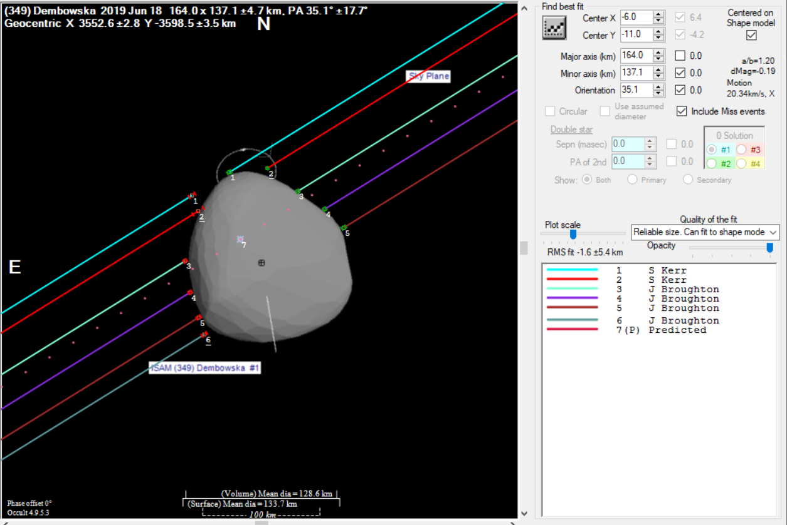
18 June 2019 – (349) Dembowska occults HIP 53014
Bright star event (mag = 8.2) good for small optics and mobile setups.
Fits the shape model … but not perfectly.

Slide 12
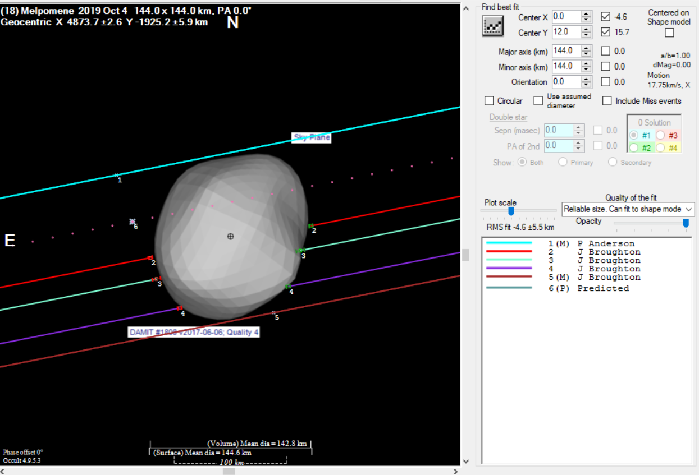
4 October 2019 – (18) Melpomene occults UCAC4 356-158790
Mobile video stations by John Broughton combine with a visual observation from Peter Anderson fits the shape model well.

Slide 13
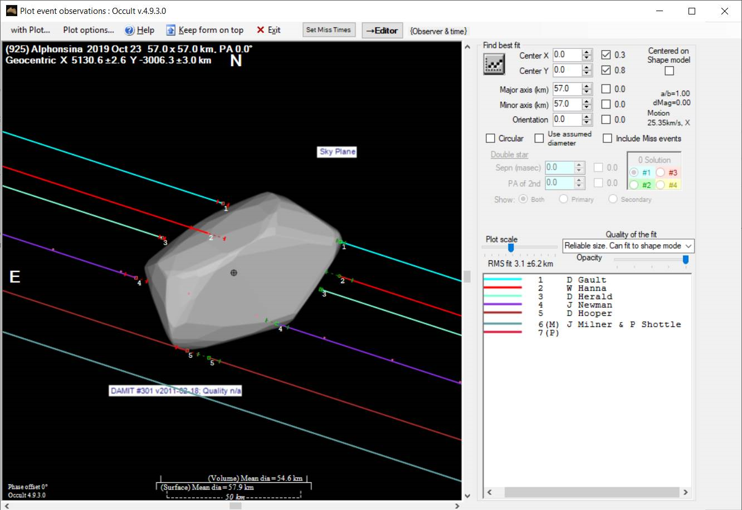
23 October 2019 – (925) Alphonsina occults UCAC4 332-176006
Lots of observers over a wide area combine to get a result that fits the shape model … Okish …

Slide 14
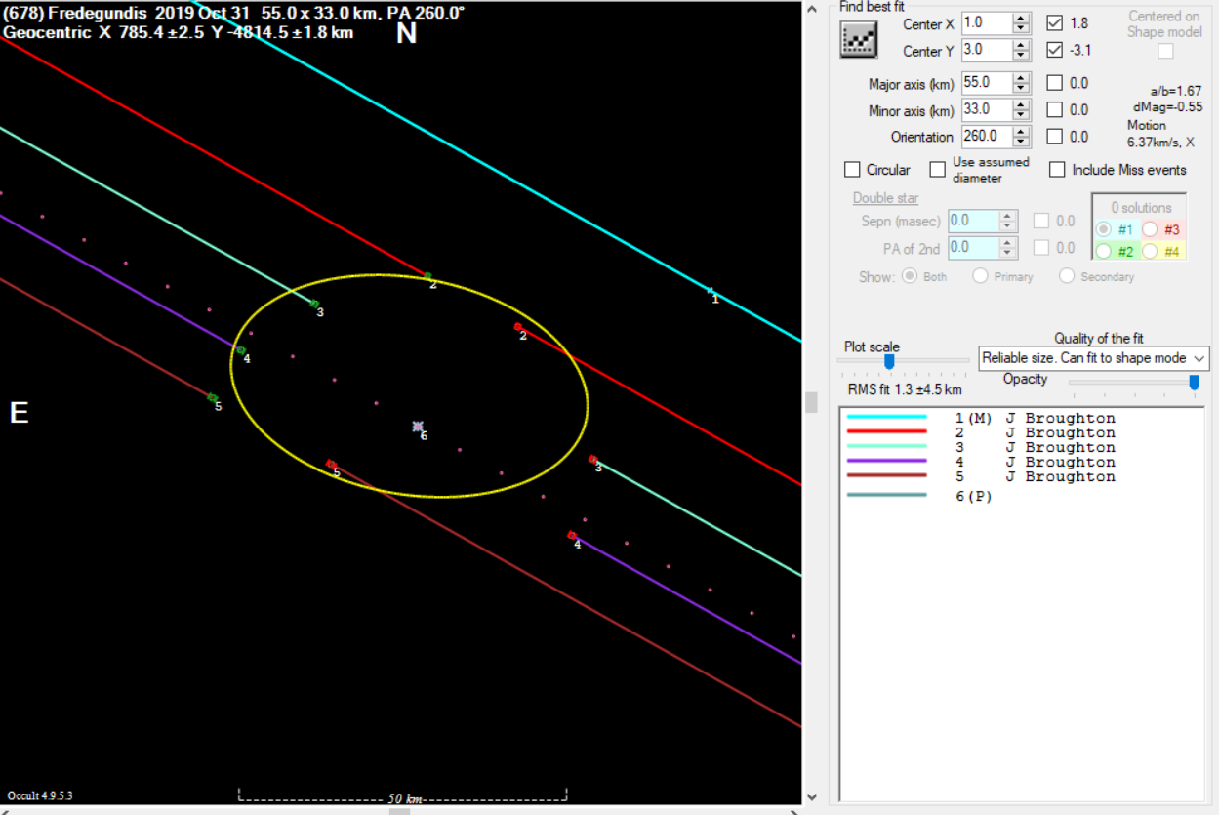
31 October 2019 – (678) Fredegundis occults HIP 9153
Very irregular shape
But consistent with earlier observations albeit with better coverage.

Slide 15
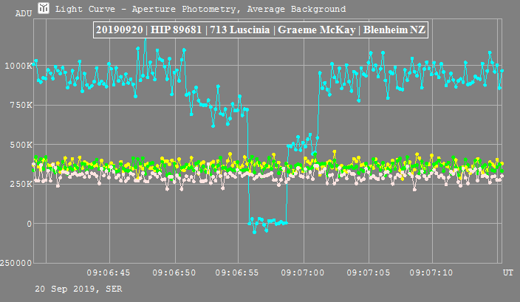
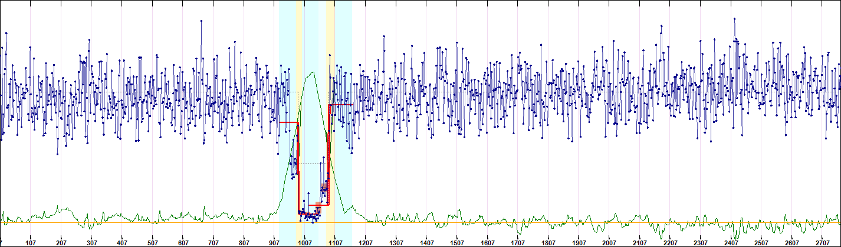
Some double star discoveries …
Aug 3 - (4004) List’ev –
UCAC4 250-090193
D. Herald

Slide 16
Reporting
Please use the MS Excel report form. Best of all, use the prefill functionality out of Occultwatcher … even better if you use AOTA to generate the times and uncertainties.
Report forms need to change to accommodate digital imaging systems… not a trivial process but we are starting that process in cooperation with IOTA.
Post you results to MPObservations@occultations.org.nz
If it is a miss, just send the Excel form. If you get a positive, send a graphic of the light curve (PNG, JPEG or GIF) as well. The .lc file out of Tangra is a good idea too.
Share your successes (and failures and embarrassing stories) on the TTOA IO Group or on Facebook (W4N2H).

Slide 17
Thanks
Questions ?

