Slide 1
Astrometry from Asteroidal Occultations
Dave Herald

Slide 2
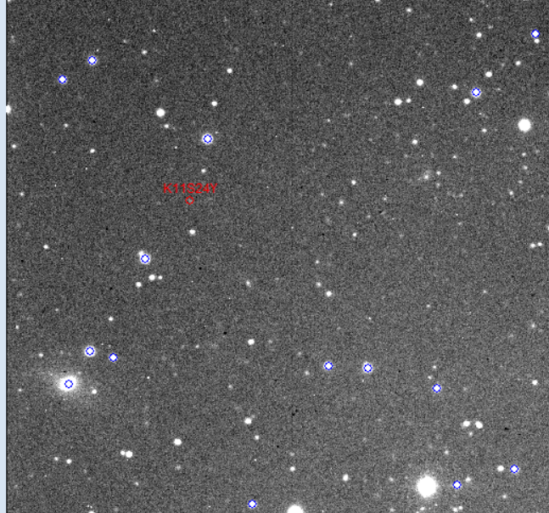
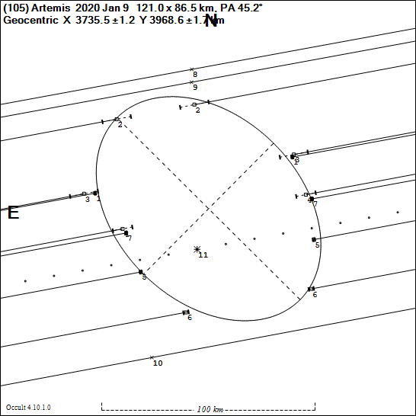
CCD vs Occultations
Reference stars in blue. Target
Asteroid (2011 SY24) in red
{one of my discoveries}
Asteroid unresolved
Position determined by a single star, with (hopefully) multiple chords accurately locating the center of the asteroid relative to that star.
Asteroid highly resolved

Slide 3
Topic of this presentation
The astrometric accuracy we can potentially achieve with asteroidal occultations is far greater than almost any other form of optical astrometry
A result is that there is a range of issues that are too small to be relevant for ‘normal’ astrometry, but become important for asteroidal occultation astrometry
In this presentation I will go through the range of issues that have to be dealt with

Slide 4
High precision astrometry
Occultation astrometry is reported as an offset from the occulted star.
99.7% of occulted stars have Gaia DR2 positions
For a well-observed occultation, the astrometric uncertainty can be as low as 0.0001” – that is, 100 µ-arcsec

Slide 5
Some background #1
Prior to Hipparcos, all star catalogs had limited precision. [basic cause - you can never measure the relative positions of stars on opposite sides of the sky – such as the distance between Polaris and σ Octans] Typical uncertainties 0.3” to 0.5”
All astrometry of asteroids before UCAC2 was based on old star catalogues, with no simple transformation to Hipparcos or Gaia
Problems with old positions continue to adversely affect orbit solutions –and hence current predictions

Slide 6
Some background #2
Hipparcos provided the reference frame for UCAC catalogues – with much improved accuracy
Gaia essentially removed star accuracy as an issue for typical modern CCD astrometry of asteroids
Nevertheless, most astrometry reported to the Minor Planet Center has an uncertainty of around 200 mas or more.
We need accuracy at around the 10mas level (or smaller) for reliable path predictions
This disjoint is why current path predictions are usually inaccurate
Most amateurs are used to thinking in units of 1 arcsec We need to be thinking in units of 1 mas or less

Slide 7
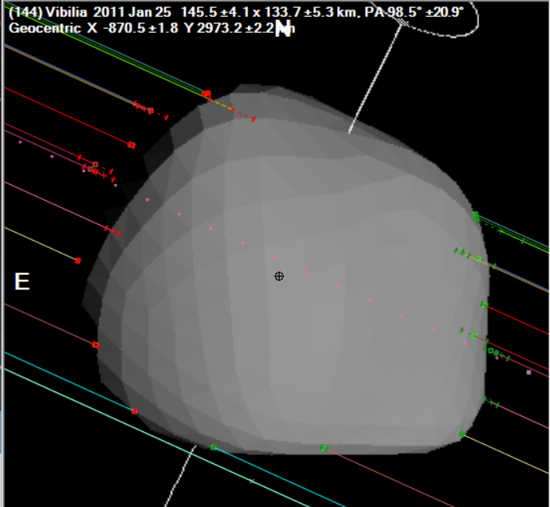
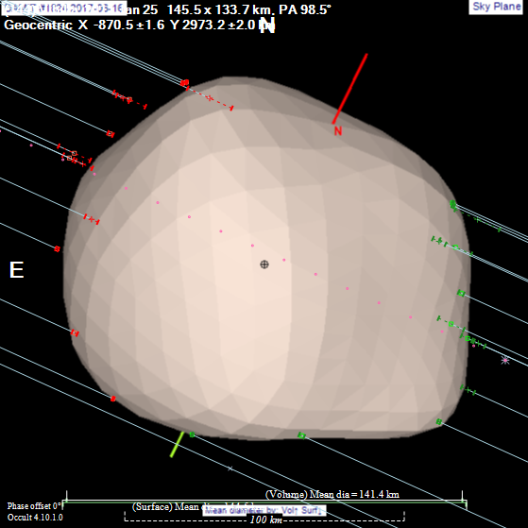
CCD Astrometry Limitations #1 Phase effects
Orbital motion is dictated by the location of the centre of mass
Traditional CCD astrometry measures the centre of light of an asteroid
Solar illumination affects the location of the center of light – both from the varying reflectance across the illuminated portion of the asteroid, and the asteroid’s (generally) gibbous appearance
Solar illuminated,
phase affected
⇔
True profile
Black marker is centre of mass (assuming uniform density). The centre of solar illumination is clearly displaced to the right located to the right

Slide 8
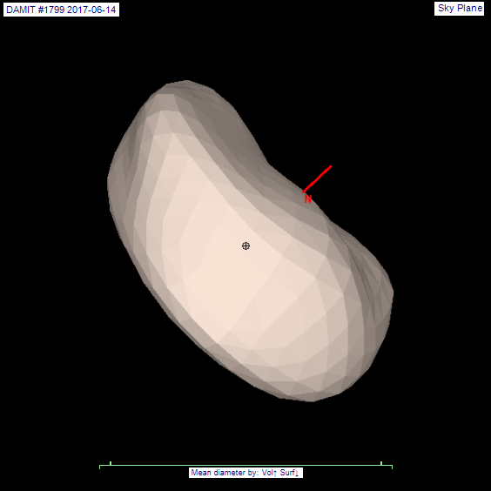
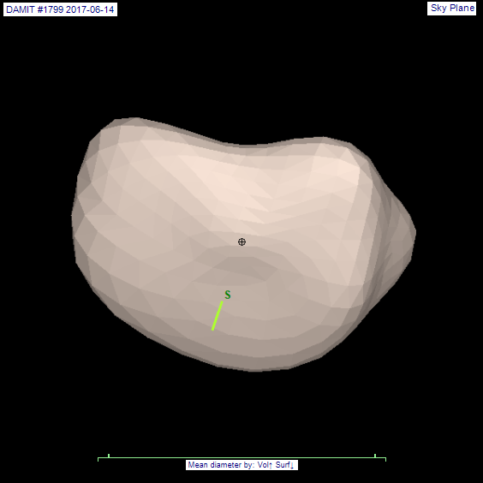
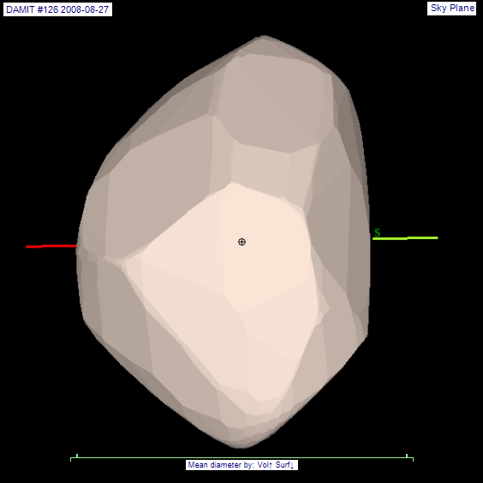
CCD Astrometry Limitations #2 Shape effects
For irregular asteroids, the shape of the asteroid can result in the center of light at particular orientations being quite different from the center of mass
Black marker is centre of mass (assuming uniform density). The centre of figure is clearly located somewhere different to the marker.

Slide 9
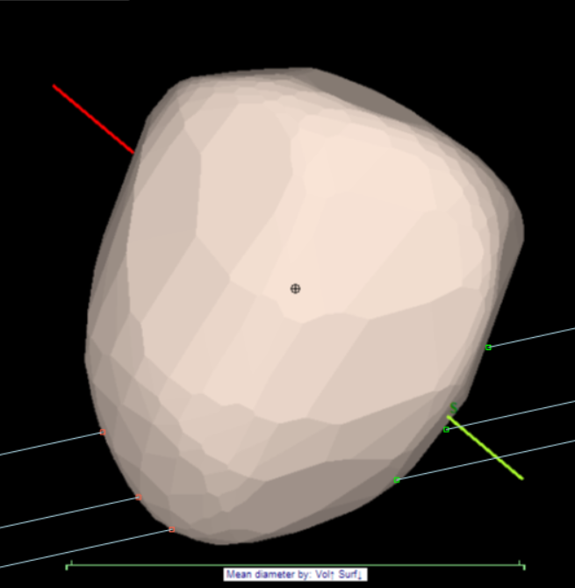
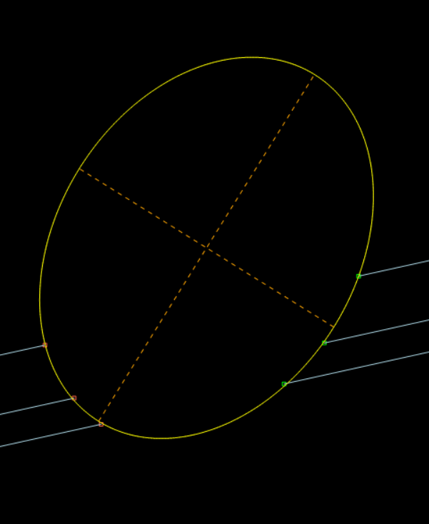
Occultation Limitations #1
Poor chord distribution. Compare where the center of the asteroid is for the following event, without and with a shape model!

Slide 10
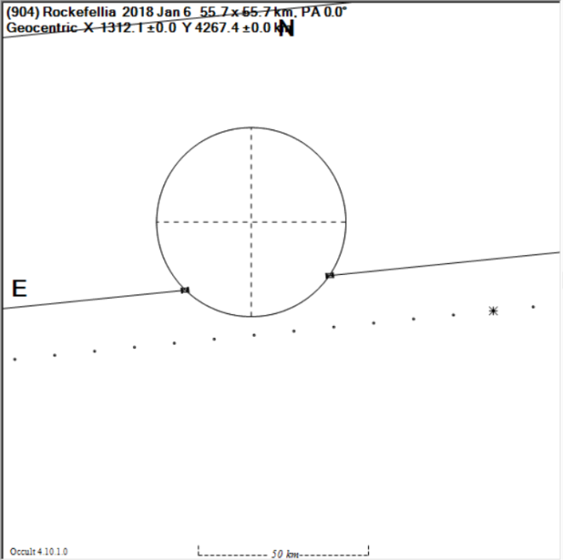
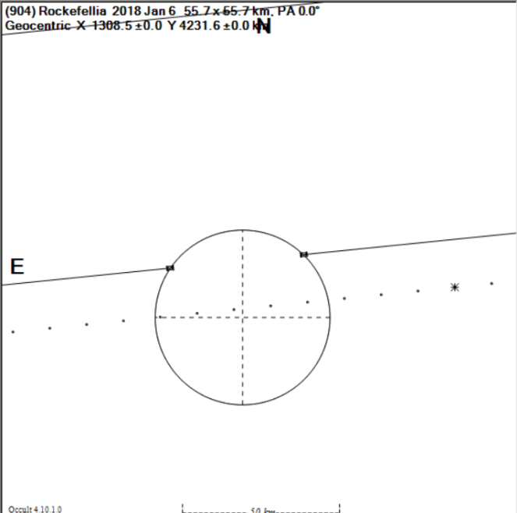
Occultation Limitations #2
Single chord observation. Which side is the asteroid on? Predictions have too much uncertainty to assist with that decision. Across path uncertainty about ±80% asteroid radius. Along-path uncertainty generally much smaller.

Slide 11
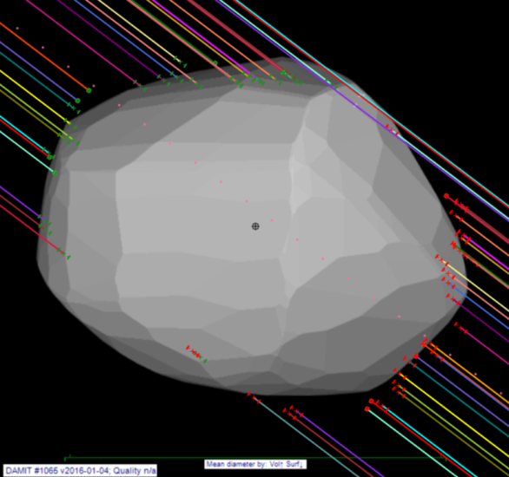
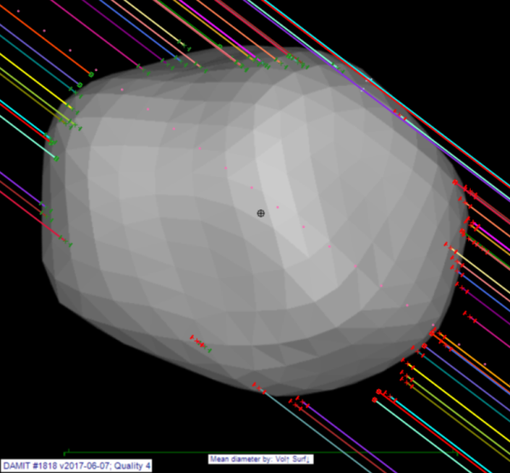
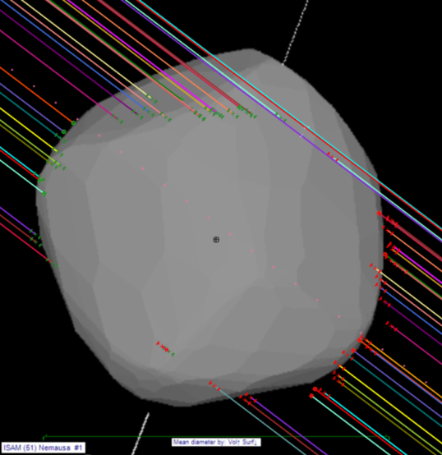
Occultation Limitations #3
Which is the correct shape model to identify the center of mass?
Bottom chord looks to have ‘problems’
1st model reasonable.
2nd model better.
3rd model – clearly wrong

Slide 12
Technical issues #1 Timing uncertainty
Uncertainty in the event time arising from the uncertainties from each reported D and R time
Can compute an RMS value for the overall time uncertainty
Some observations don’t have reported uncertainties
Some observations have unrealistically small uncertainties
The smallest uncertainties are generally associated with single-chord observations….
The average for the entire dataset is 1.5 secs

Slide 13
Technical issues #2 Star position uncertainties
At current dates, the uncertainty in a Gaia DR2 position is generally in the range 0.2 to 1.5mas
For events in the 1980’s, it is about 5mas
For stars brighter than mag 12.5, Gaia DR2 has an error arising from the different detectors used for bright stars. The correction is <1mas for current dates, but can be many mas in the 80’s & 90’s

Slide 14
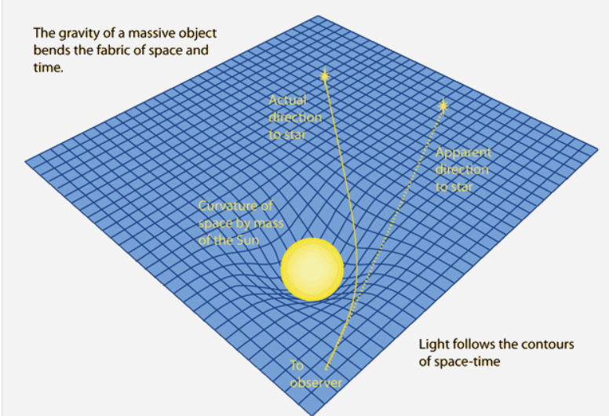
Technical issue #3 Relativity 101
A light path is bent as it passes through the solar gravitational field
The amount of bending depends on the path length through the gravitational field
The light bending for an asteroid that appears ‘on top of’ a star is ALWAYS less than the light bending for the star
Apparent direction to Star & Asteroid
Actual direction to Asteroid
Actual direction to Star

Slide 15
Relativity 101 #2
For an asteroid at 3 AU from the Earth the following table indicates the differential deflection at different solar elongations
Solar Elongation | Deflection of the asteroid relative to the star
1° | 156 mas
15° | 10 mas
45° | 3 mas
90° | 1.1 mas
135° | 0.4 mas
165° | 0.1 mas
At the precision obtainable in asteroidal occultations, deflection by the Sun is relevant for most solar elongations, not just events close to the Sun
That is, your observations as ‘amateurs’ directly involve the effects of relativity
For the 2019 July 29 occultation by (3200) Phaethon, the differential deflection was about the same as the path width.

Slide 16
Relativity 101 #3
For an asteroid at 45 deg solar elongation, the following table indicates the differential deflection at different distances to the asteroid
Asteroid distance (AU) | Deflection of the asteroid relative to the star
0.5 | 8.8 mas
1 | 7.1 mas
2 | 4.4 mas
3 | 3.1 mas
5 | 1.9 mas
10 | 1.0 mas
20 | 0.5 mas
The difference in deflection of the asteroid relative to the star is still significant at distances well beyond Uranus

Slide 17
Reporting astrometry from occultations
When a shape model is available, differences between the centre of figure and centre of mass become apparent
Whenever possible, we will be reporting astrometry derived from Occultations to the Minor Planet Center based on Center of Mass. However the IAU standard ADES needs to be updated to allow this to happen.
Extract of an astrometric report in ADES format….
permID |provID |mode|stn|obsTime |raStar |decStar |deltaRA |deltaDec|rmsRA |rmsDec|astCat |com|
6| |OCC |244|2019-01-01T15:23:23.85Z| 94.57830780| 5.98653780| 3.7771| -5.0411|0.0084|0.0158| GDR2|0 |
6| |OCC |244|2019-01-14T03:50:36.88Z| 91.68994530| 7.90771260| 0.4213| 3.8808|0.0003|0.0003| GDR2|0 |
6| |OCC |244|2019-02-04T11:59:15.35Z| 89.13044205| 11.53498680| -0.0918| 2.2475|0.0907|0.0907| GDR2|0 |
12| |OCC |244|2019-01-17T22:00:52.75Z| 51.00970935| 15.25879300| 2.1970| 2.3123|0.0426|0.0426| GDR2|0 |
15| |OCC |244|2019-04-27T17:18:33.15Z|318.28846875|-15.95389700| -1.9653| -1.2354|0.0018|0.0025| GDR2|0 |
16| |OCC |244|2019-02-08T13:12:17.29Z|288.16164090|-20.41309960| -1.7603| 1.5196|0.0035|0.0285| GDR2|0 |
18| |OCC |244|2019-06-26T06:13:20.06Z|280.95155790| -8.63512850| -2.0251| 4.6716|0.0102|0.0413| GDR2|0 |
23| |OCC |244|2019-01-11T22:53:27.29Z| 28.93467885| 9.17252450| 3.1163| 2.6017|0.0369|0.0369| GDR2|0 |
25| |OCC |244|2019-01-17T18:17:19.50Z| 93.66505440| -5.60617100| 3.3456| 2.4467|0.0190|0.0722| GDR2|0 |
39| |OCC |244|2019-03-07T17:40:55.49Z|301.17339015|-13.46387930| -2.1839| -1.4195|0.0033|0.0153| GDR2|0 |
50| |OCC |244|2019-04-01T22:36:33.20Z|172.62366960| 3.49482950| 0.4524| 2.6472|0.0010|0.0008| GDR2|0 |
50| |OCC |244|2019-06-25T12:47:19.38Z|172.91053110| 3.87288430| 1.9023| 1.4413|0.0000|0.0000| GDR2|0 |

Slide 18
Occultations to support space missions
We all know about (486958) Arrokoth (was Ultima Thule) & New Horizons….
Japan will be launching DESTINY+ in 2022 to explore (3200) Phaethon – the Apollo asteroid responsible for the Geminid meteor stream
JAXA keen to get precise position of the asteroid, and measure of its size
IR satellite measures: AcuA 4.8 km IRAS 5.1 km

Slide 19
(3200) Phaethon outcomes
Successfully observed in the US on 29 July
Event tested the accuracy of prediction software of all
Gravitational deflection (caused by the Sun) of the asteroid relative to the star was similar to the 5km width of the occultation path
Event provided a unique opportunity to compare and improve prediction software
Unfortunately a subsequent event on Aug 21 in Japan was clouded out.

Slide 20
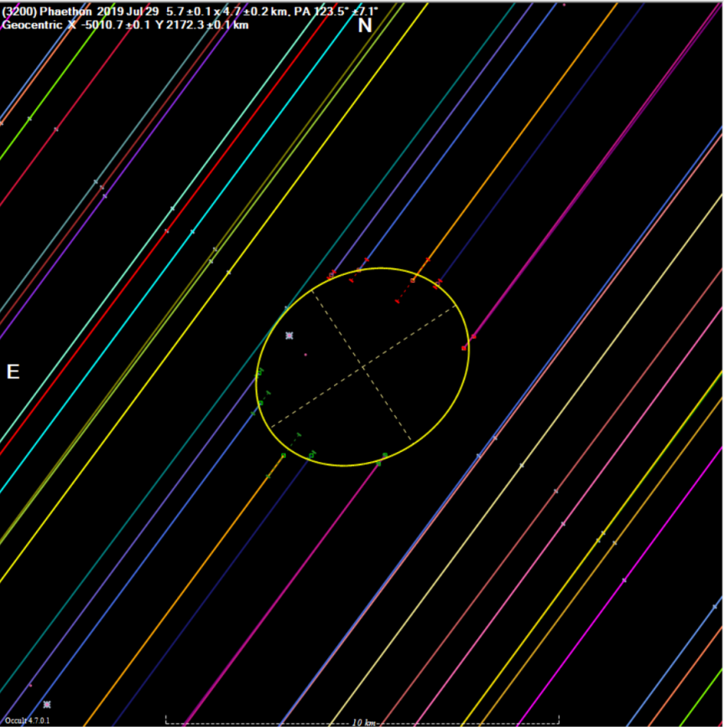
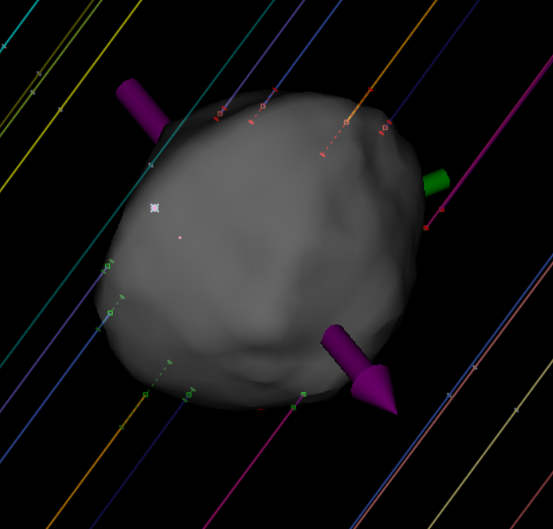
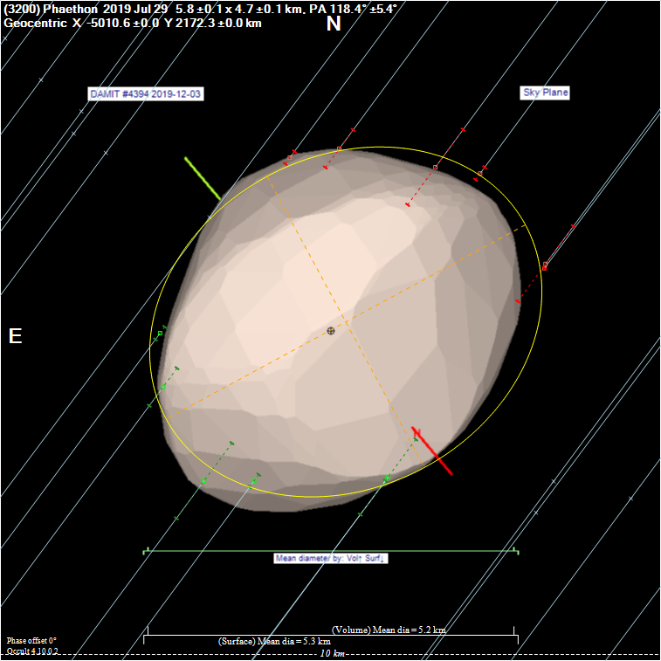
Phaethon - preliminary results
Ellipse 5.7 x 4.7 km
Fit to a shape model
=> Diameter = 5.2 km
⇒ Diameter is larger than AcuA and IRAS by ~ 5%

Slide 21
Questions?

